Slide 1
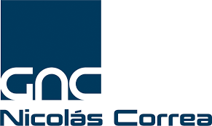
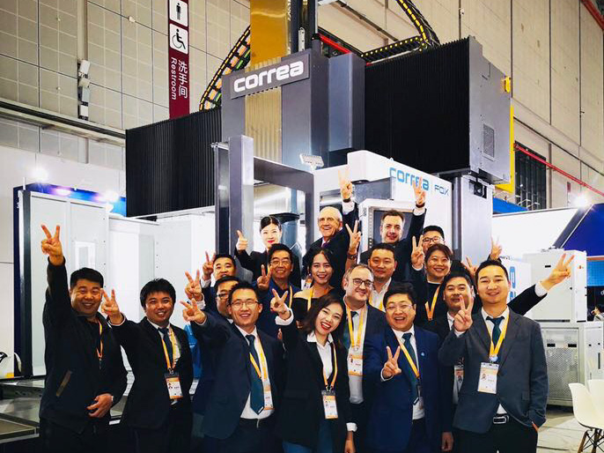
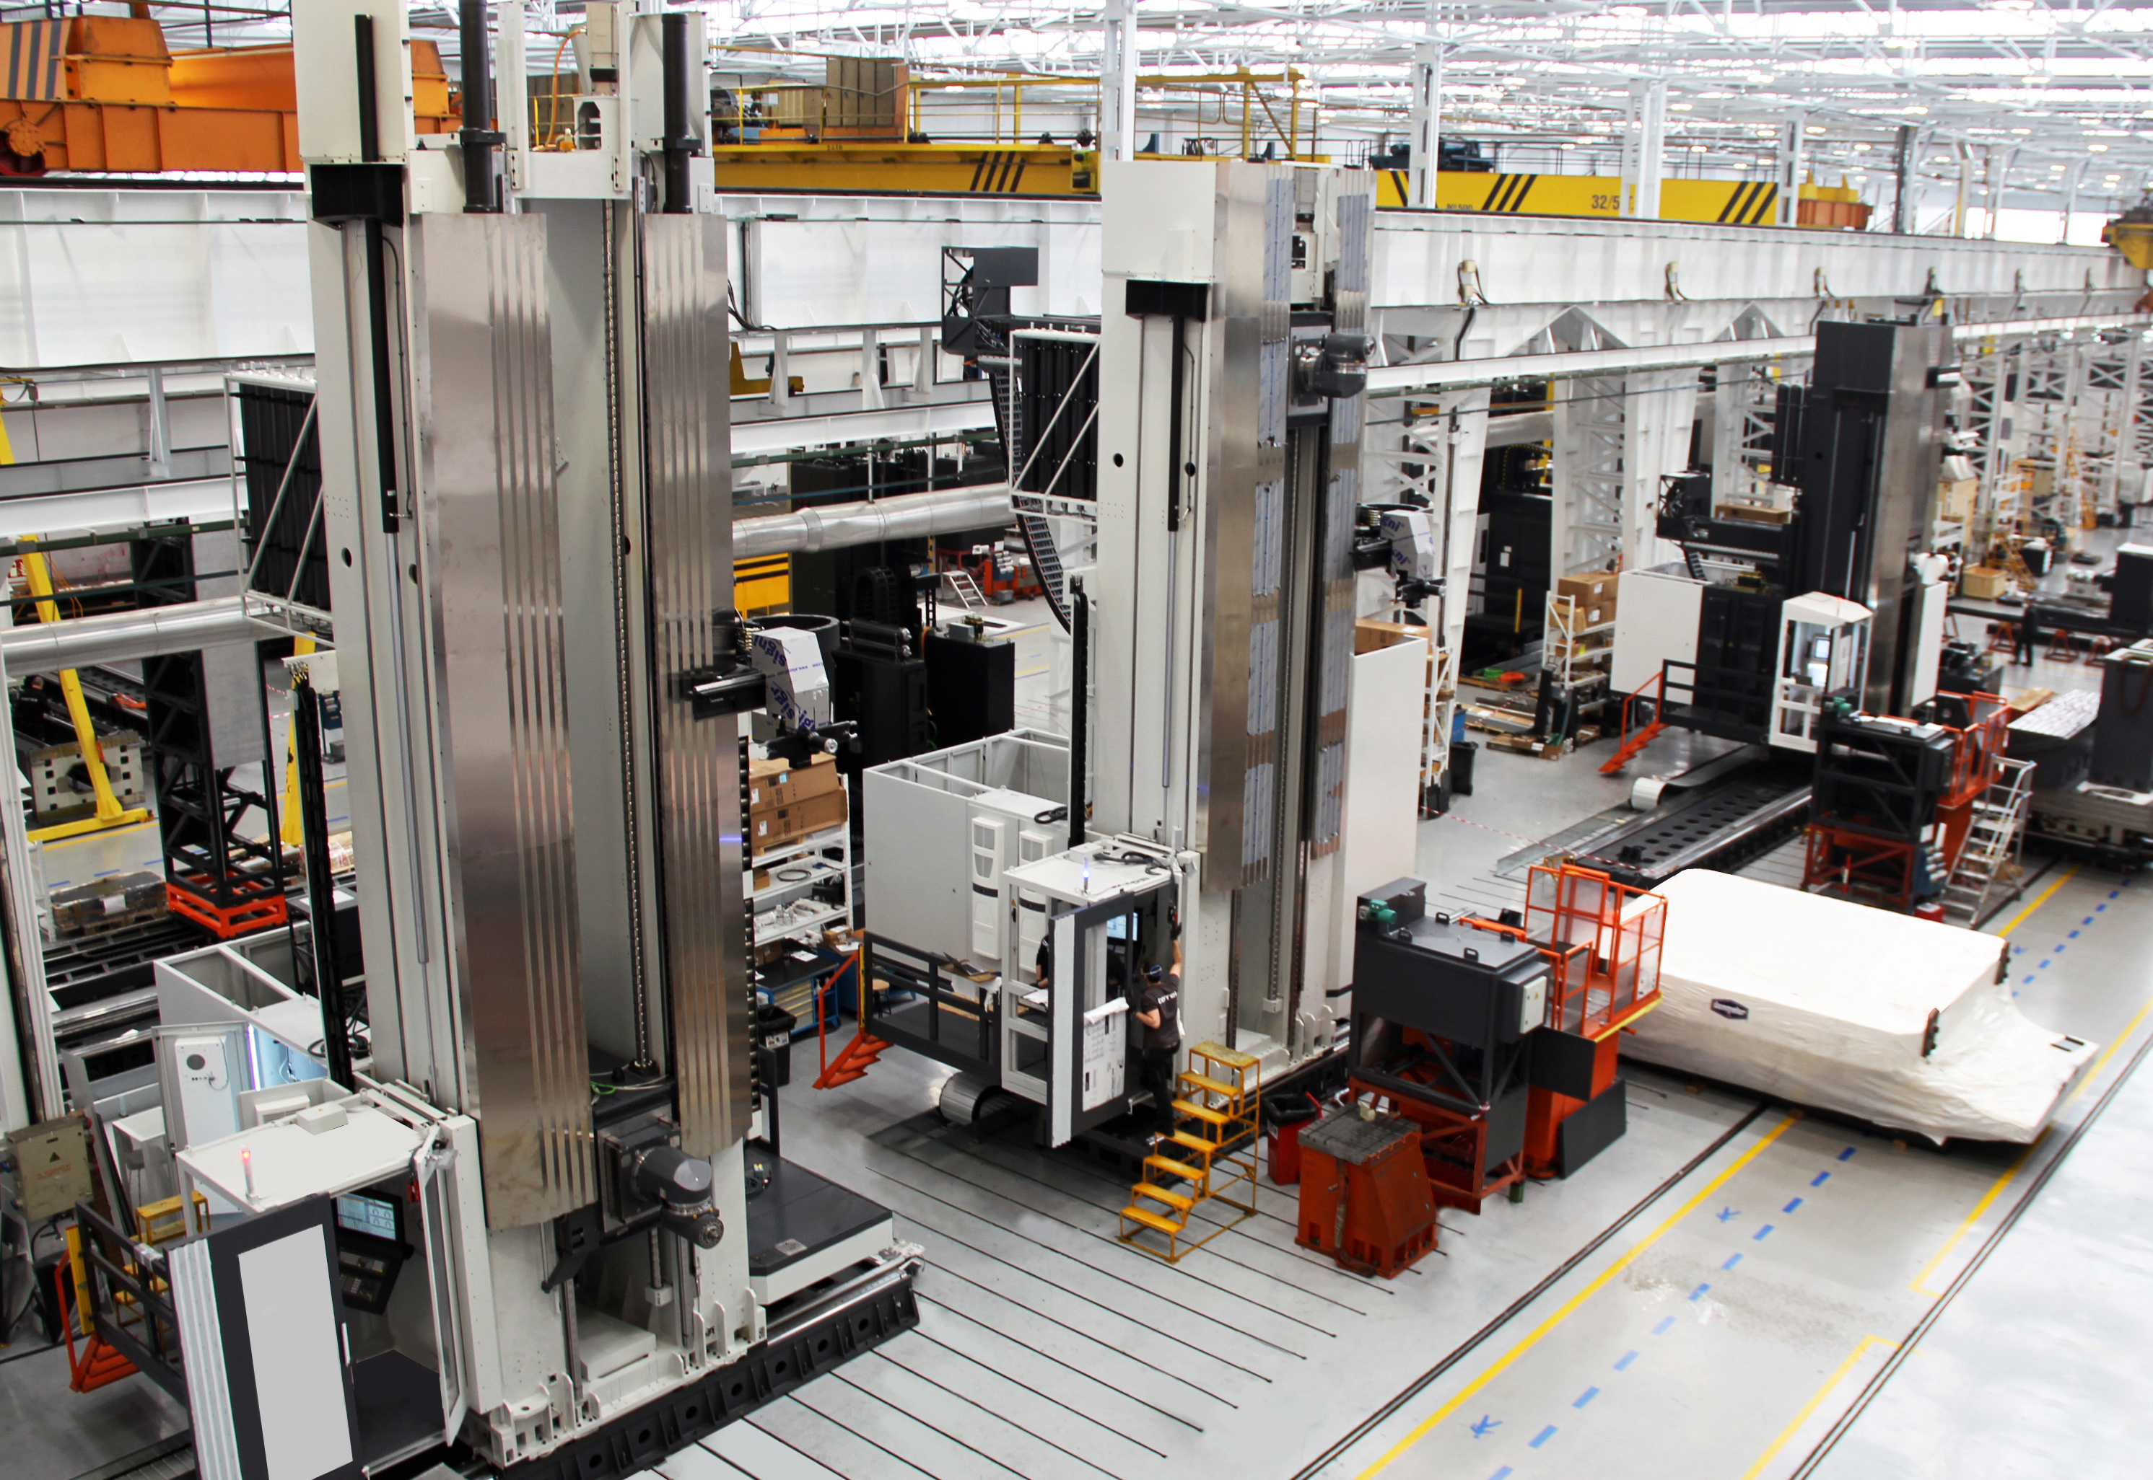
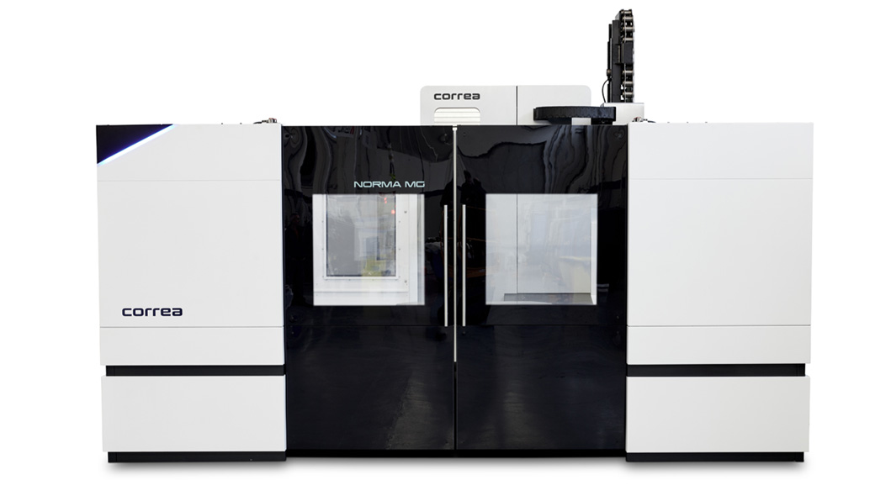
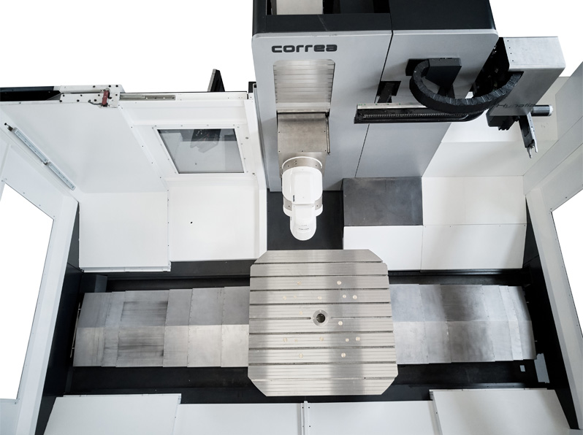
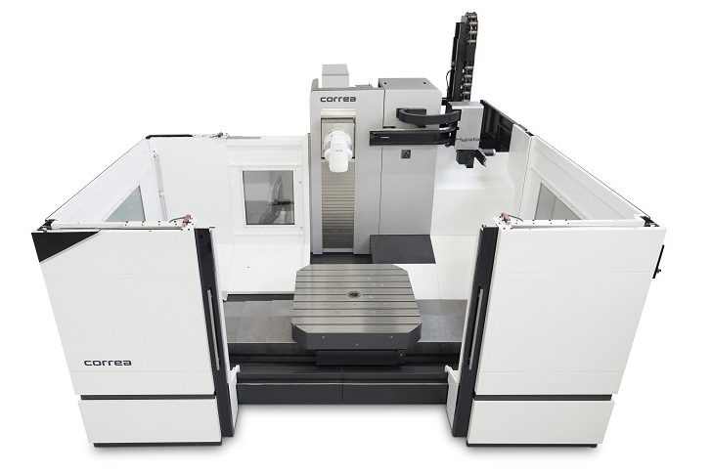
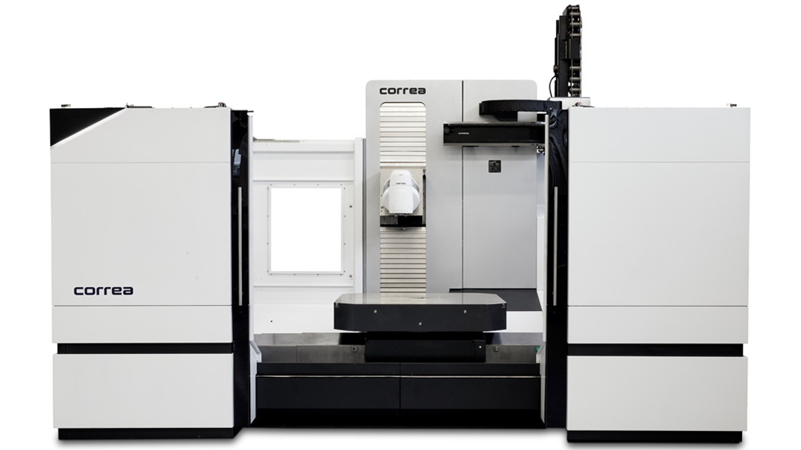
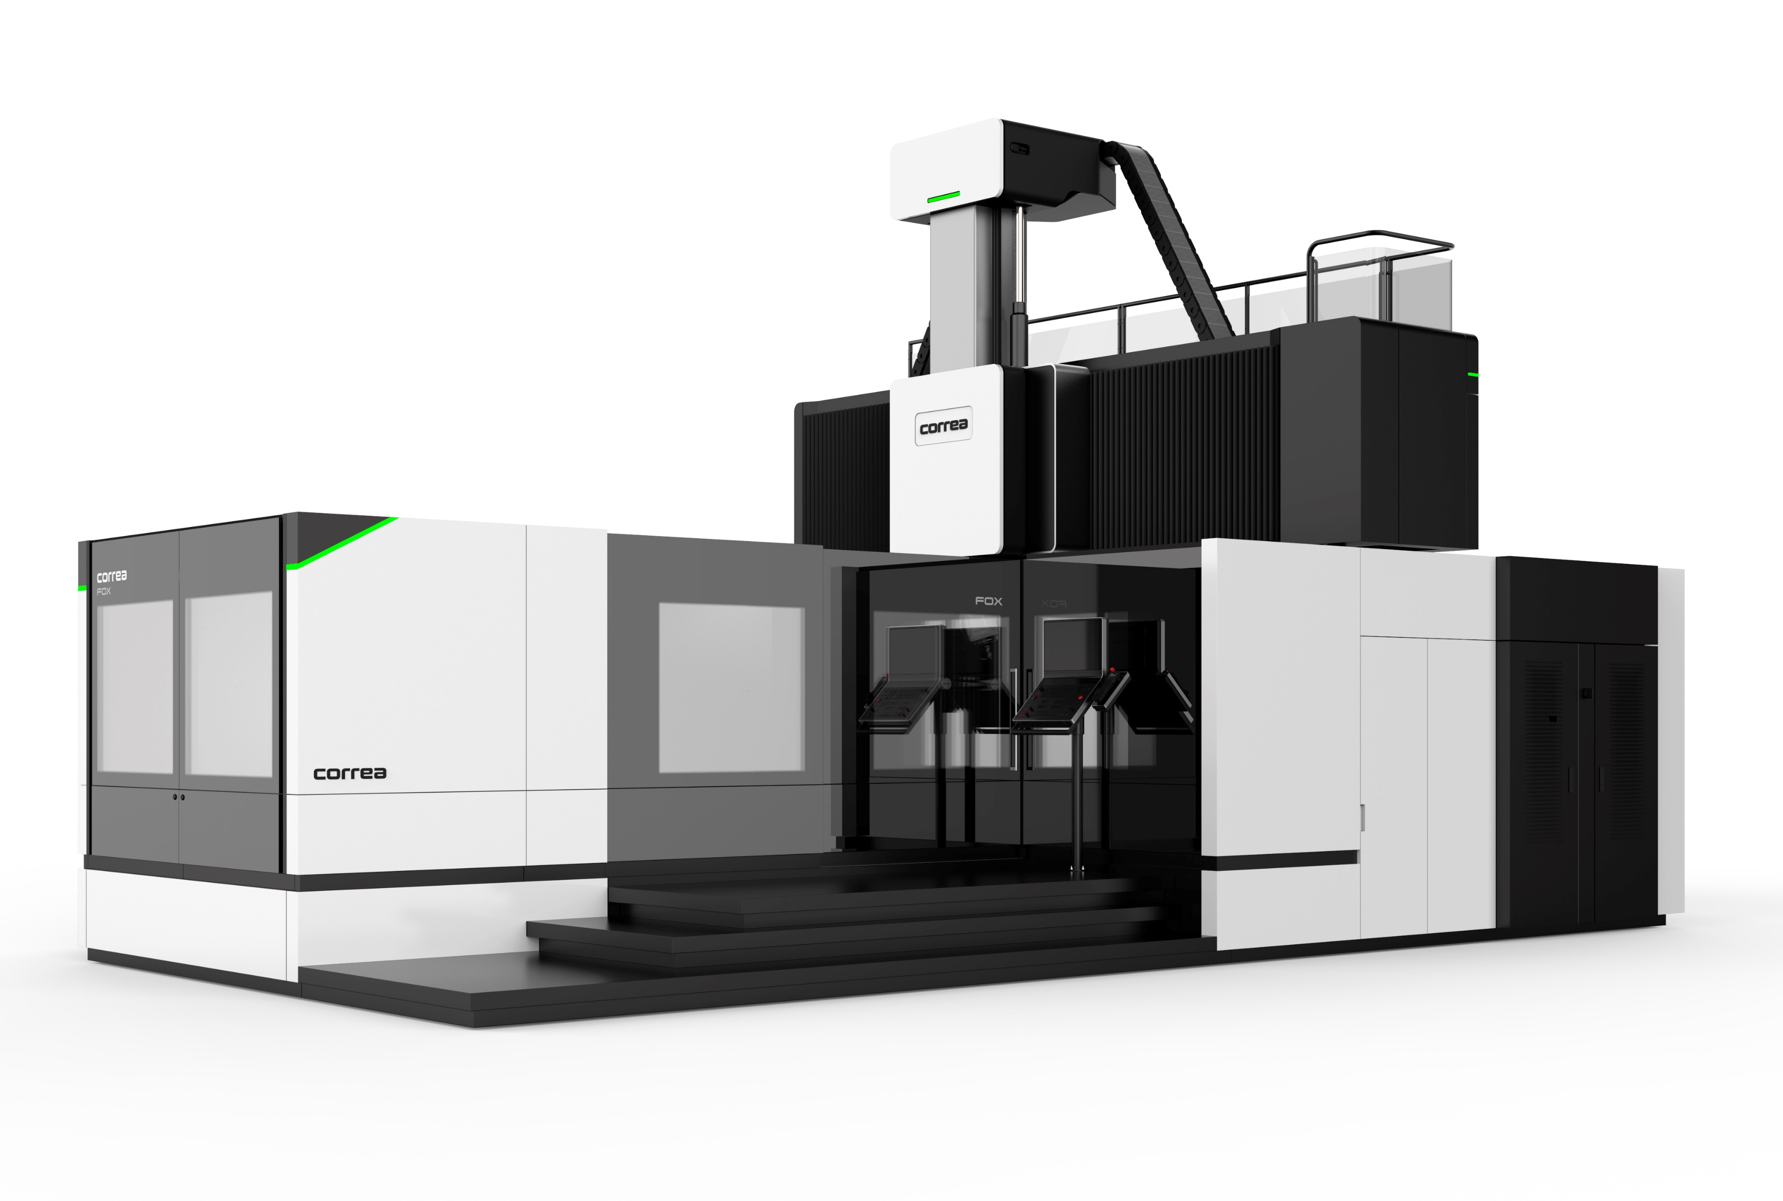
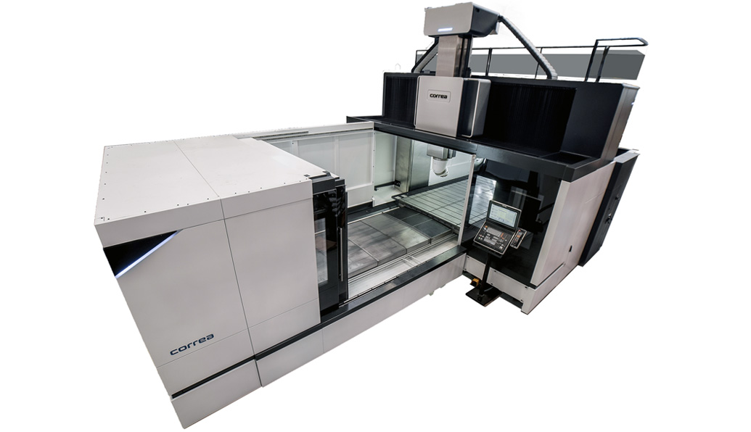
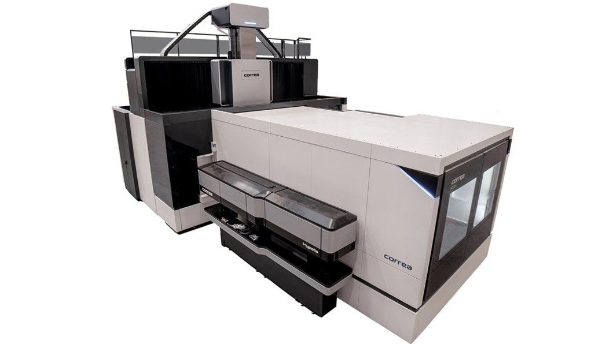
With over 800 bridge type machines and over 600 floor type machines installed all over the world, it is one of Europe´s leading companies in the field of milling solutions designed to work in the most demanding production enviroments, such as the power generation, automotive, aerospace and railway industries.
Tailand, Bangkok.
Indonesia, Arcadia
Indonesia, Bekasi
India, Pune
China, Skangai
China, Kunming
South Korea, Seoul
Arab Emirates, Sharjah
Malaysia, Sleangor
Nicolás Correa in Asia Pacific
ENVIROMENT
Enviromental excellence, sustainability and eco-design
POLICY & STRATEGY
COMMITENT TO ENVIROMENT
Main objetives
Customer-geared, ensuring customer satisfaction as the main strategic goal of the company.
Commitment to the business project, to make the mission and vision reality.
Work as a team to facilitate participation and the exchanche of ideas taking máximum advantage of the diversity of knowledge.
Iniative to make headway in the search for new solutions and their implementation.
Honesty as a fundamental trait to generate trust and credibility in the work performed and in the organization itself.
Social responsability to contribute to the improvement of social well-being.
Environmental performance
EXHIBITIONS
MILLING MACHINE RESEARCH & DEVELOPMENT
Nicolás Correa has an R&D&I department which ir constantly growing and which currently accounts for 17% of the whole workforce. It is made up of a team of highly-qualified engineers, capable os developing multidisciplinary projects and operating at a global level thanks to the use of English as the everyday working language.
SOME OF THEIR NEW PRODUCTS
Bed-Type with rotary table milling machine NORMA MG
Bridge type milling machine FOX
Correa milling head UCE
Insertar video https://www.youtube.com/watch?v=WcdFCweNAzg&feature=youtu.be
MILLING MACHINES APPLICATION ENGINEERING
Nicolás Correa has an applications department made up by specialists with extensive experience in machining parts for different industries.
SERVICES
Best machine configuration: Our applications team will analyse the parts to be machined and configure your machine, heads and accessories accordingly.
Time study: Our team can carry out a study of the machining time required for a specific part, specifying the cutting conditions and tool to be used in each operation.
Machining tests: Our team can carry out both standardised and customised machining tests (upon request) in order to assess different machine behaviours.
Turnkey solutions: We offer turnkey solutions for specific parts in which we feel we have sufficient experience. In such cases, the applications team will define the entire process, including the final machining of the first parts.
Training: We provide training on the customer's premises in the operation of the Heidenhain i530, Heidenhain i640 and Siemens 840D CNCs.

